Slide 1
BigData – Spark – Processing Spark cluster mode distribution & Tuning
Course Esilv 2024
arnaud.nauwynck@gmail.com
this document:
https://github.com/Arnaud-Nauwynck/presentations/pres-bigdata/ Spark-ClusterMode

Slide 2
Outline
Reminder Spark-driver / spark-executers
Cluster Tuning Params
deployMode (local, spark://, yarn, k8s)
Others launchers (java embedded, livy, jupyter, pyspark ..)

Slide 3


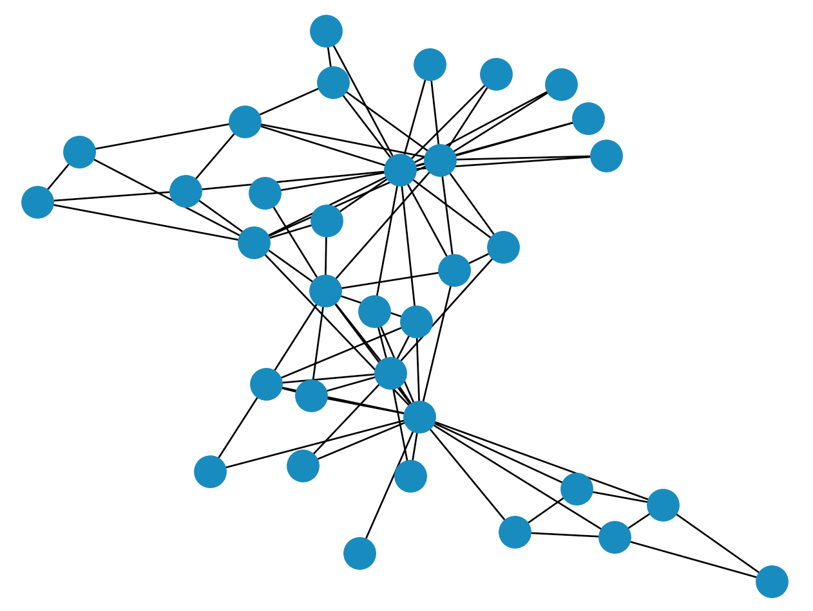










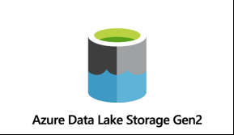







Spark-Core + …
Structured Data
Reminder
Modules
DataSource Connectors
(Hadoop API)
Cluster Manager
Core
Langages Support

Slide 4
1 Spark application = 1 Spark-driver + N spark-executers
Reminder

Slide 5
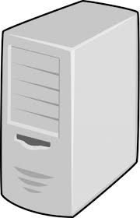

Read N Files – assign Tasks to Executors
Reminder
(5) Send tasks progress/status
(4) exec read task
N Files
(2) read N files
metadata
(3) Send tasks to executors
Task_i = « read file_j »
(1) Directory List files
spark-driver
spark-executors

Slide 6

Parallelizable per partition / available Cpu 1 or several partitions per Executor ..1 or several Executors
Reminder
Worker node 1
Worker node 2
Spark executor process 1
Spark executor process 3
Spark executor process 2

Slide 7

WholeStageCodeGen
Reminder
Program
= Dataset instructions
(3) Send task + bytecode
to spark-executors
Generate java code (RDD Spark sub-class « WholeStageCodeGen$i »)
(2) Compile Bytecode
(4) Execute tasks

Slide 8

Cluster Manager Extensions: TaskScheduler API
Reminder
abstract class TaskScheduler {
..start(),stop(),
submitTasks,cancelTasks,
notify Host-Executor-Task changes
}

Slide 9
Reminder

Slide 10
CoarseGrainScheduler … CoarseGrain Executer
Reminder
Spark-driver
Implements Fault Tolerance+Distribution
Spark-executor
… internally called « CoarseGrainExecutor » main loop
CoarseGrain
partition
= unit or recomputation

Slide 11

Outline
Reminder Spark-driver / spark-executers
Cluster Tuning Params
deployMode (local, spark://, yarn, k8s)
Others launchers (java embedded, livy, jupyter, pyspark ..)

Slide 12

Tuning Spark to use cluster power ? Distribution / Partitions / Parallelism

Slide 13
Memory needs for Dataset driver != executer

Slide 14
DataSet = Partitions metadata / data
1 Partition
= p rows
(p1 != p2 != ..pN)
Row
Row
Row
Row
Row
1 Dataset
= N partitions
Row
Row
Row
Row
Row

Slide 15
On Driver = metadata / on Executor = Datas
Row
Row
Id
location
Row
Row
Id
location
Row
Row
Row
Id
location
Row
Row
1 Dataset on spark-driver
N x Partitions (blocks) on spark-executors

Slide 16
DataSet … Partitions Distributed on Executors
Executor 1 (JVM process)
Driver (JVM process)
Row
Row
1 Dataset<Row>
= N « views » of partitions
Row
Executor 2 (JVM process)
Row
Row
Row
Row
Row
Executor 3 (JVM process)
Row
Row
Row
Row
NO data here
Only « location » info of partitions
Row
Row
Row

Slide 17
dataset = Spark.createDataset( inmemoryList ) … serialize (send) data to Executors
Executor
Driver
List<Object>
Object[0]
Object[0]
Object[2]
Object[1]
Before :
In-memory
objects
On Driver
Object[4]
Object[2]
Object[3]
Executor
Object[N]
Object[1]
After :
Partition
infos
Object[3]
Object[5]

Slide 18
Memory needs on Driver << Executors
Executor
Object[0]
Object[2]
Object[4]
Executor
Driver
Object[1]
Object[3]
Object[5]

Slide 19
Spark Memory Arguments
Executor
Driver
--driver-memory 1g
--executor-memory 50g
spark.driver.memory=1g
spark.executor.memory=50g

Slide 20
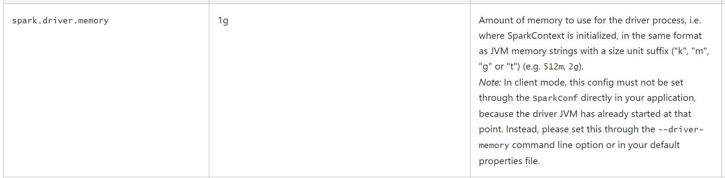
Spark Memory … to {driver|executor} java –Xms .. –Xmx ..

Slide 21
Use Cluster Resources : Distributing N executors

Slide 22
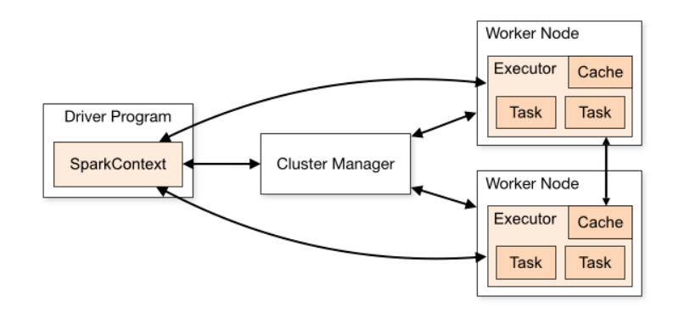
Cluster Manager (SPI)

Slide 23
Executors .. JVM processes launched on Cluster
create NEW resource
Worker Node
Worker Node
Ask NEW resource
Executor
(JVM process)
Other
processes
Driver
(JVM process)
Worker Node
Worker Node
Executor
(JVM process)
Other
processes

Slide 24
Driver … Launch spark-executors
${JAVA_HOME}/bin/java
-server -Xmx30720m
-Djava.io.tmpdir=/yarn/local/usercache/<user> /appcache/<application_id>/<container_id>/tmp
-Dspark.history.ui.port=18080
-Dspark.driver.port=33029
-Dspark.yarn.app.container.log.dir /yarn/log/<application_id>/<container_id>/
org.apache.spark.executor.CoarseGrainedExecutorBackend
--driver-url spark://CoarseGrainedScheduler@<driverhost>:33029
--executor-id 1
--hostname <executorhost>
--cores 5
--app-id <application_id>
--user-class-path file:/yarn/local/usercache/<user> /appcache/<application_id>/<container_id>/__app__.jar
JVM args
Main class
main(
String[] args)

Slide 25
Spark Cluster arguments
Executor
Driver
--num-executors 5
spark.executor.instances=5

Slide 26
spark.executor.instances .. for Static allocation
.. See also Dynamic Allocation

Slide 27
Dynamic Allocation
Executor
Driver
Upscale
Downscale
--spark.dynamic.allocation.enabled true
--spark.dynamic.allocation.{min | max | initialExecutors | executorIdleTimeout | … }

Slide 28
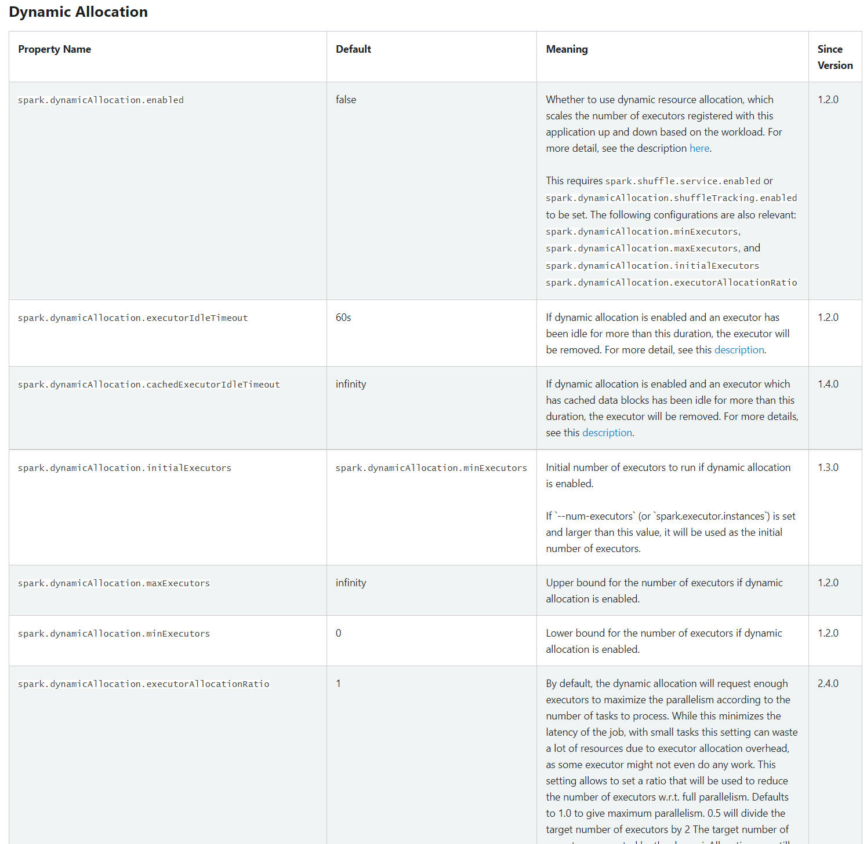
Dynamic Allocation arguments

Slide 29

Dynamic Spark + Dynamic K8s Cloud Cluster
2) Upscale "NodePool"
=> Allocate NEW Worker (VM)
.. for Pending « spark executor »
Alloc/free
resource
1mn to
quit Spot
WorkerNode (Virtual Machine via Cloud)
Executor
3) Downscale "NodePool"
OR Spot VM reclaimed by Cloud
1) Upscale
.. Add POD
in Existing Node
Driver
Executor
Executor

Slide 30
Spark dynamicAllocation <==> K8s NodePool autoScaling
=> more (system) VMs from Cloud Provider
=> when full: NodePool "TriggerScaleUp" (VM provisionning may take ~3mn)
=> need more k8s resources
allocating new (applicative) "executor"
releasing (applicative) "executor"
=> use less k8s resources
=> when empty (0 running pod on Node), VM could be evicted from NodePool
(example: configure with 15mn delay)
=> less (system) VMs from Cloud Provider

Slide 31
K8s NodePool, Afinity, Toleration, Spot VM ..
Node Pool 2
Big VMs … « SPOT »
(cheaper, may be reclaimed by cloud)
=> for spark Executors
Node Pool 1
Small VMs … reserved
=> for long running services, spark Drivers

Slide 32
Use CPU Resource: 100% or sharing ?

Slide 33

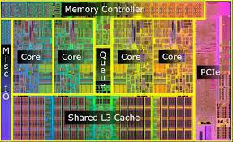
Cpu Cores <-> Threads <-> max Active Tasks
Executor Service
Thread Pool
CPU
x Cores
Task FIFO
Queue
Pool Thread 1
Pool Thread 3
Pool Thread 2
Pool Thread N
…
Pending Tasks
Active Tasks
(assigned to pooled Threads)

Slide 34
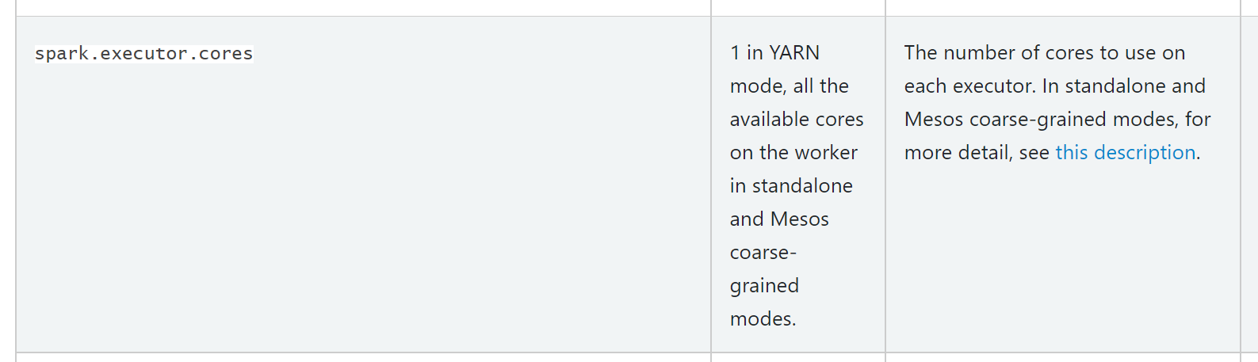
Executor Cores argument
--executor-cores N
spark.executor.cores=N

Slide 35
Relationship executor .cores <-> .memory
--executor-cores 10
--executor-memory 50g
1 Active Core => 1 Task => read 1 File Block => 1 Dataset Partition => … maybe 1 x 256 Mo (compressed) … 1 x Go ?

Slide 36
Summary main arguments
--executor-cores N
Executor
spark.executor.cores=N
Driver
--driver-memory 1g
spark.driver.memory=1g
--executor-memory 50g
--num-executors 5
spark.executor.memory=50g
spark.executor.instances=5

Slide 37
Outline
Reminder Spark-driver / spark-executers
Cluster Tuning Params
deployMode (local, spark://, yarn, k8s)
Others launchers (java embedded, livy, jupyter, pyspark ..)

Slide 38
$ spark-submit --master ${mode} ….
${mode}: one of
local[N]
mesos (deprecated)
spark://
yarn
k8s

Slide 39
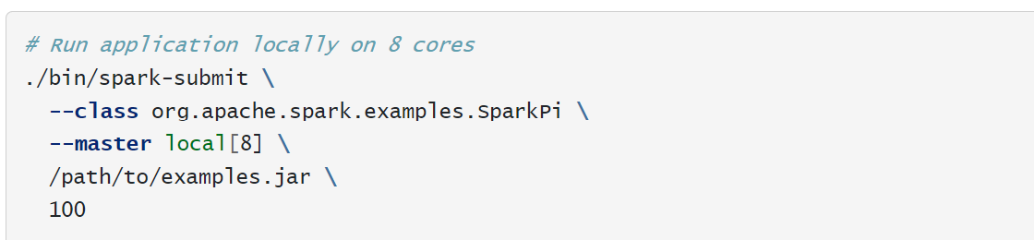
--master local[*]

Slide 40
Local mode: 1 JVM client = driver = executors
JVM process
Client part
Driver part
Executors part
Task Executor
Spark-submit main
SparkContext
ThreadPool
Create
context
Send
tasks

Slide 41
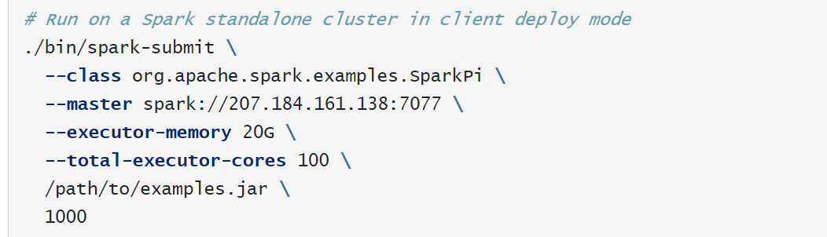
--master spark://<sparkServer>:<port>

Slide 42
Spark Standalone Cluster
Create JVM processes
spark-driver
/spark-executor
Spark master
Spark workers

Slide 43
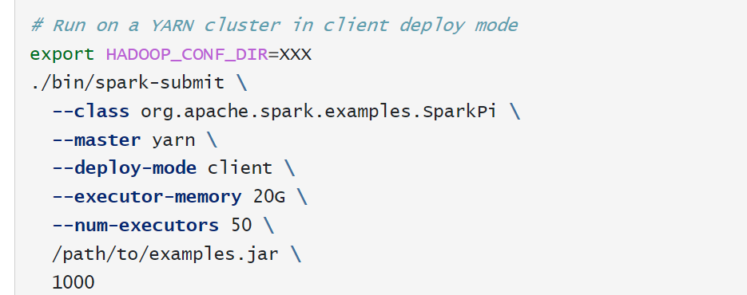
--master yarn --deploy-mode client

Slide 44

Yarn Client Mode
Client+driver (=JVM process)
spark-executor (=JVM)
Client part
Driver part
Executors part
Executors part
Executors part
Task Executor
CoarseGrainExecutorBackend
Task Executor
Task Executor
Spark-submit main
SparkContext
ThreadPool
Task Executor
ThreadPool
ThreadPool
ThreadPool
Create
context
Send
tasks

Slide 45

Pros/Cons
Easy to start: spark-submit.sh
Easy to see driver logs… as stdout !
Easy to kill (Ctrl+C / kill -9 )
Client = Driver … within firewall
Need to choose 1 server of cluster + SSH on it
Or use Oozie
If driver crash.. END
SSH to
node42 ??
Firewall
Or Connect to
« Edge » node

Slide 46
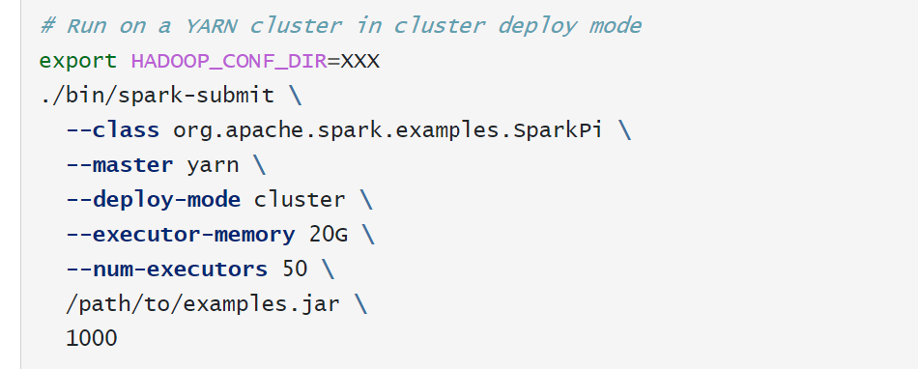
--master yarn --deploy-mode cluster

Slide 47
Yarn Cluster Mode
Client (=JVM)
spark-driver (=Yarn JVM)
spark-executor (=Yarn JVM)
CoarseGrainExecutor
Scheduler
Executors part
Start driver
Executors part
Executors part
Task Executor
CoarseGrainExecutorBackend
Task Executor
Task Executor
spark-submit main
SparkContext
ThreadPool
Task Executor
ThreadPool
ThreadPool
ThreadPool
Send
tasks

Slide 48
Pros-Cons Yarn « Cluster » vs « Client » mode
Client can run outside firewall / cluster
Client is ligtweight
Many Clients can run on « Edge » Node
If Driver crashes… client will relaunch driver!
More difficult to see logs (Yarn Logs!!)
More difficult to kill : yarn app –kill ${applicationId}
Kill client => does not kill driver !!
( Zombie yarn driver ? )

Slide 49
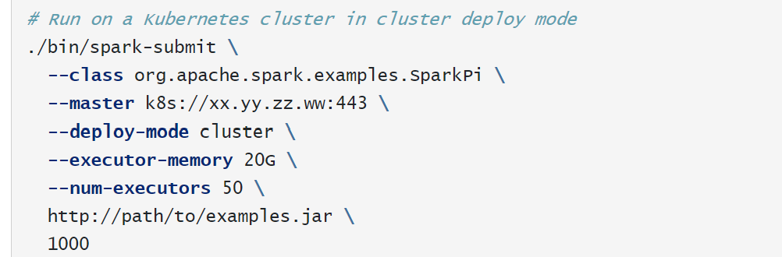
--k8s://<k8sApiServer>:443 ( basic without K8s operator)

Slide 50

Spark on Kubernetes … Docker Images/Jars
Executor = pod
(using dockerImageX)
spark-executor = pod
(using dockerImageX/Y)
Executors part
Executors part
Spark-submit .. k8s
CoarseGrainExecutor
Scheduler
Executors part
Task Executor
CoarseGrainExecutorBackend
Task Executor
Task Executor
ThreadPool
Task Executor
ThreadPool
SparkContext
ThreadPool
ThreadPool

Slide 51
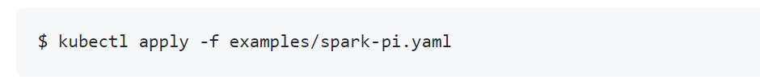
Spark on K8s with SparkOperator mode

Slide 52
Spark on K8S, using K8s SparkOperator
spark-driver = pod
(using dockerImageX)
spark-executor = pod
(using dockerImageX/Y)
$ kubectl apply <yaml>
K8S Spark Operator
Executors part
Executors part
CoarseGrainExecutor
Scheduler
Executors part
Task Executor
CoarseGrainExecutorBackend
Task Executor
Task Executor
ThreadPool
Task Executor
Spark-submit .. k8s
ThreadPool
kubectl
SparkContext
ThreadPool
ThreadPool
Spark-client… run in SparkOperator service(GO)

Slide 53
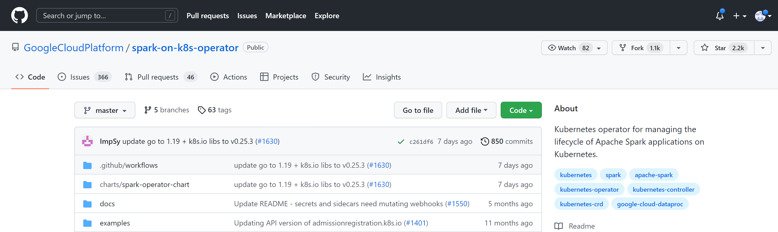
spark-on-k8s-operator : K8s CRD from Google

Slide 54
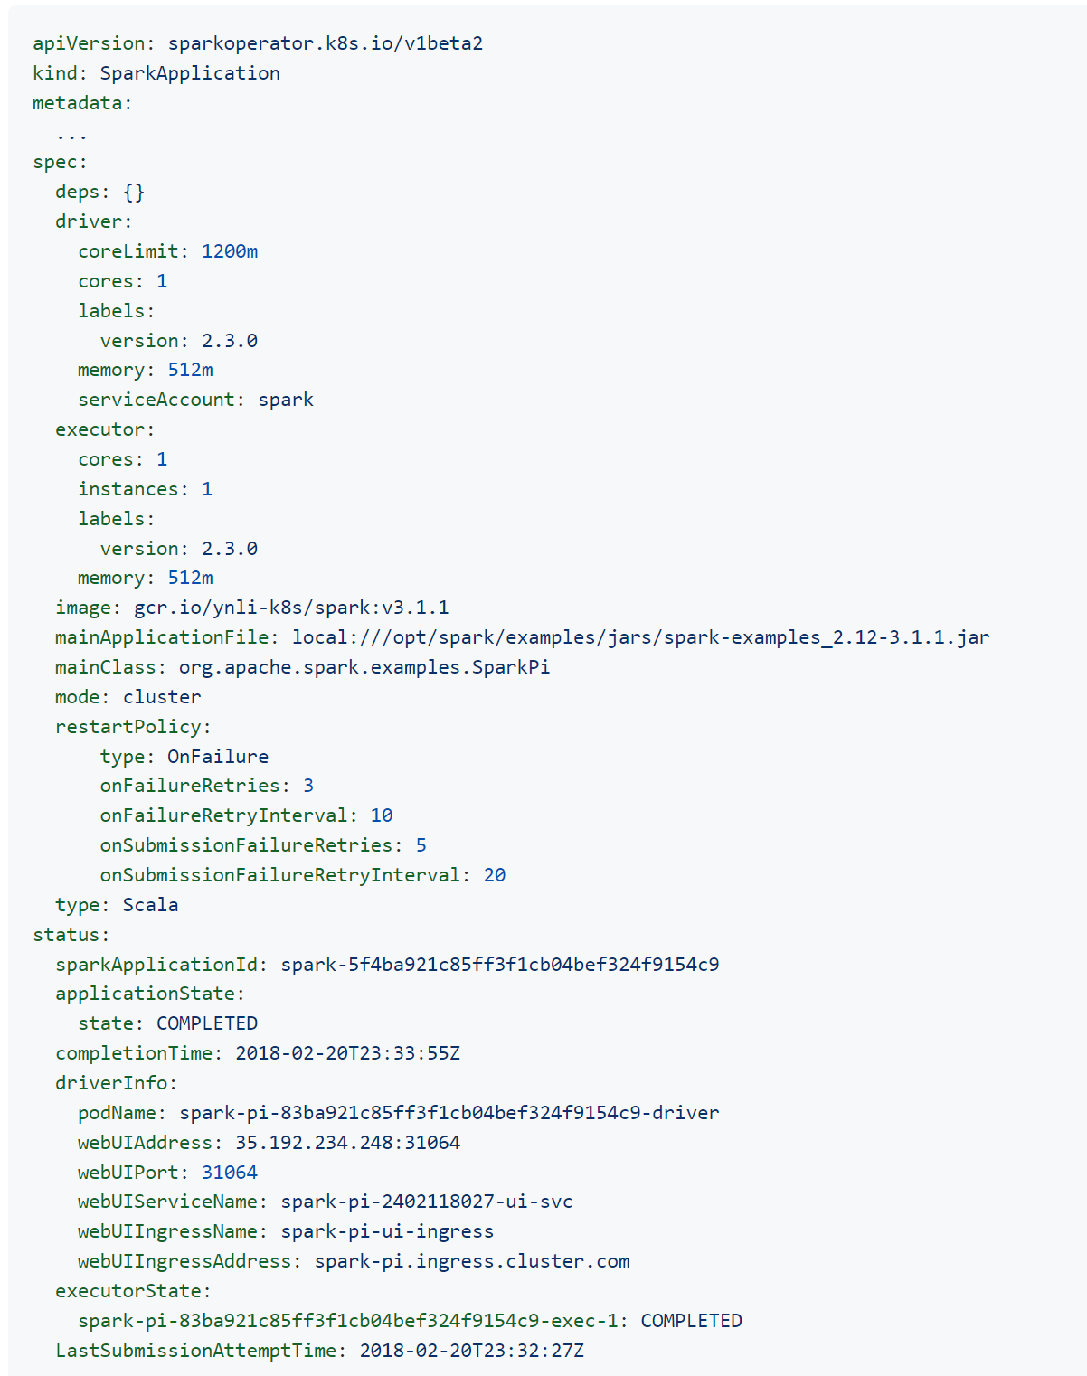
$ kubectl get sparkapplications .. -o=yaml
driver pod
executor pod
spec
Spark args
status

Slide 55
Outline
Reminder Spark-driver / spark-executers
Cluster Tuning Params
deployMode (local, spark://, yarn, k8s)
Others launchers (java embedded, livy, jupyter, pyspark ..)

Slide 56





More ways to start spark

Slide 57
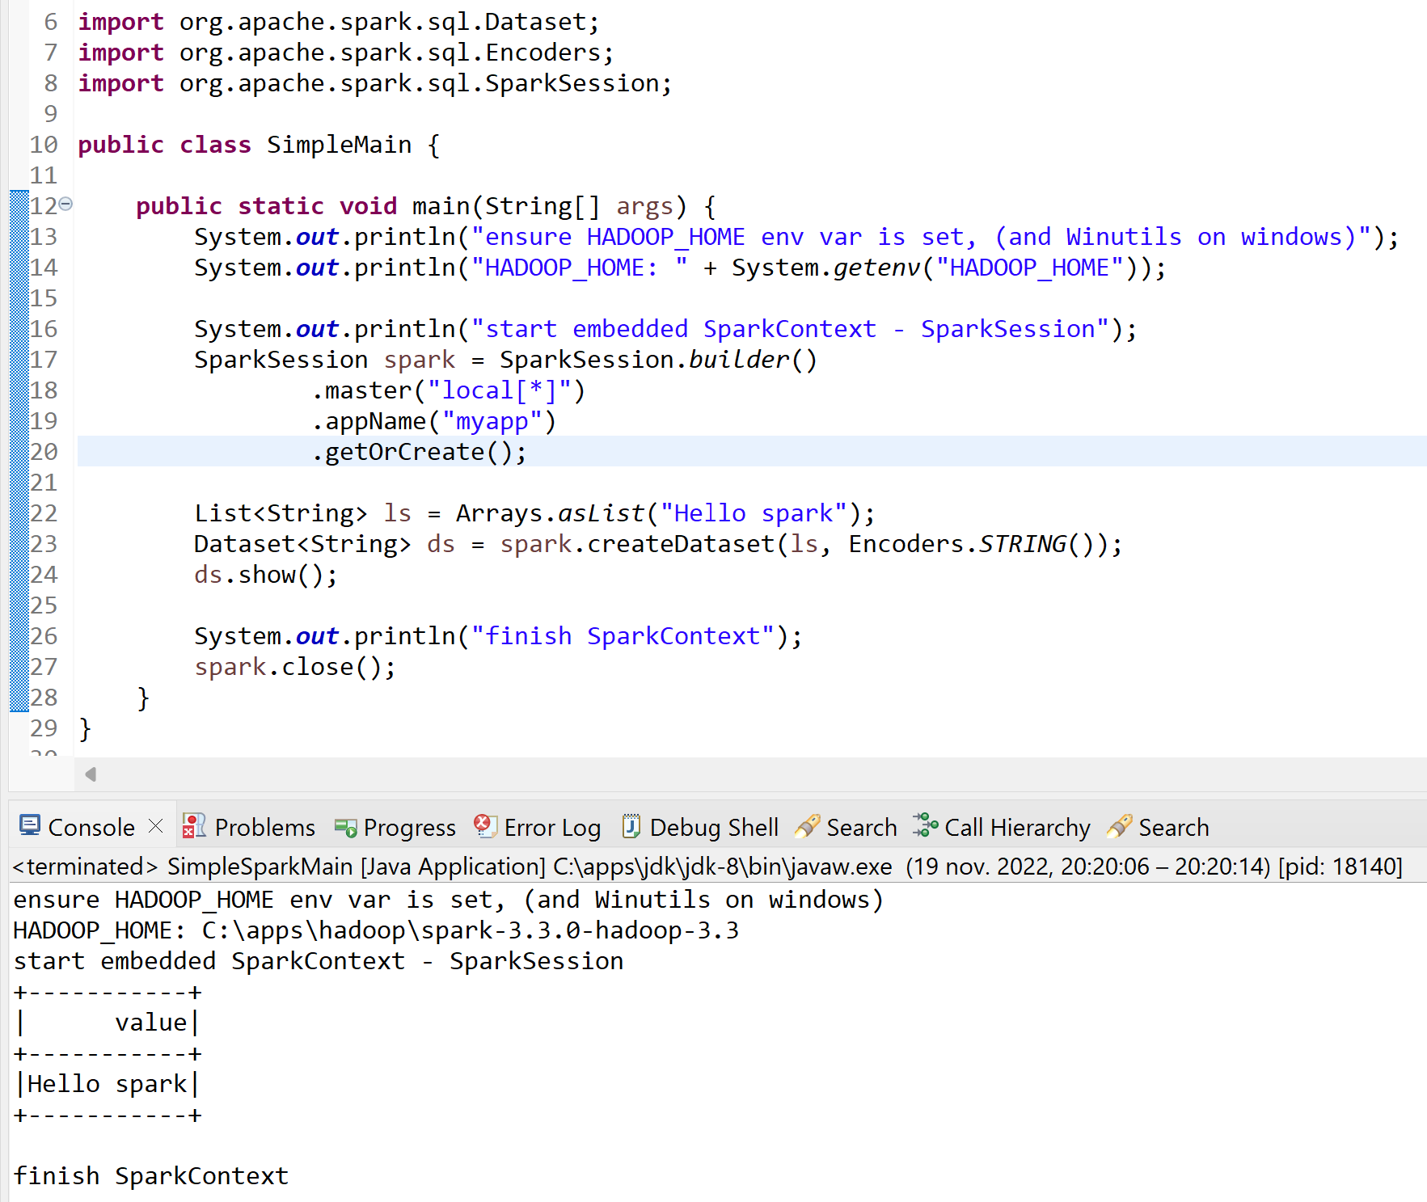
Plain old java main(String[] args) Spark « Hello World »

Slide 58
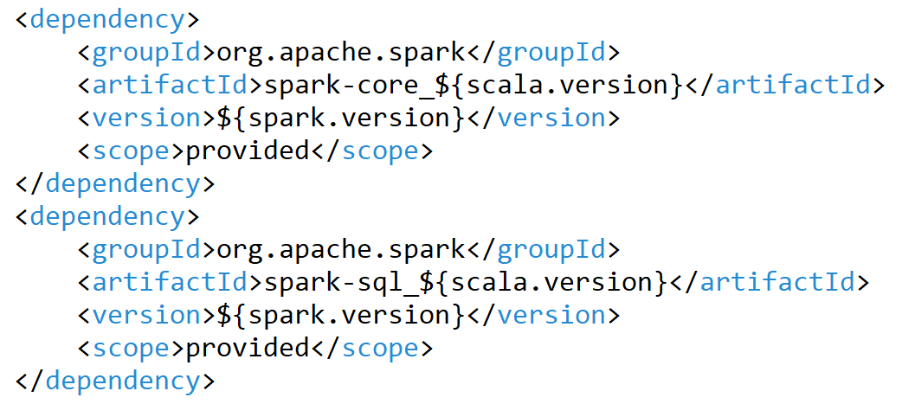
Spark maven pom.xml <dependency>
Use <scope>provided</scope> when deployed in HADOOP cluster

Slide 59
SparkContext / SparkSession ?
SparkContext = in module spark-core singleton, instanciable only on Driver, multi-thread safe
SparkSession = in module spark-sql also multi-thread safe ( ~ SparkContext + SQL UDFs, temporaryViews..)
When creating a SparkSession, it internally check/create SparkContext
It is possible to have multiple sessions ( for having different SQL UDF, temporaryView, .. per user session)

Slide 60
SparkConf – SparkContext - SparkSession
class SparkConf {
… key=value + hadoopConf
}
package org.apache.spark (module spark-core)
1
class SparkContext {
…
}
activeContext
new RDD + transforms
0..1
package org.apache.spark.sql (module spark-sql)
1
class SparkSession {
…
}
getOrCreate()
new Dataset<> + transforms

Slide 61

JavaSparkContext, JavaRDD, JavaFunction ?
Because Spark has a cleaner API in
( less verbose, using implicits + operator overload ),
some specific helper classes have been added, for Java developpers
some deprecated, ex: SQLContext

Slide 62
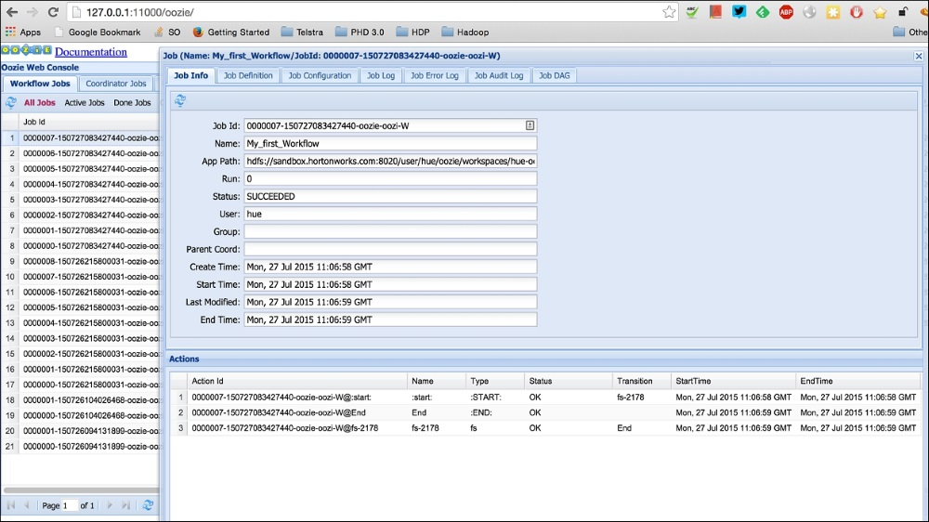
Oozie … http Api wrapper for Yarn + UI
$ curl http://<knox>/oozie/

Slide 63
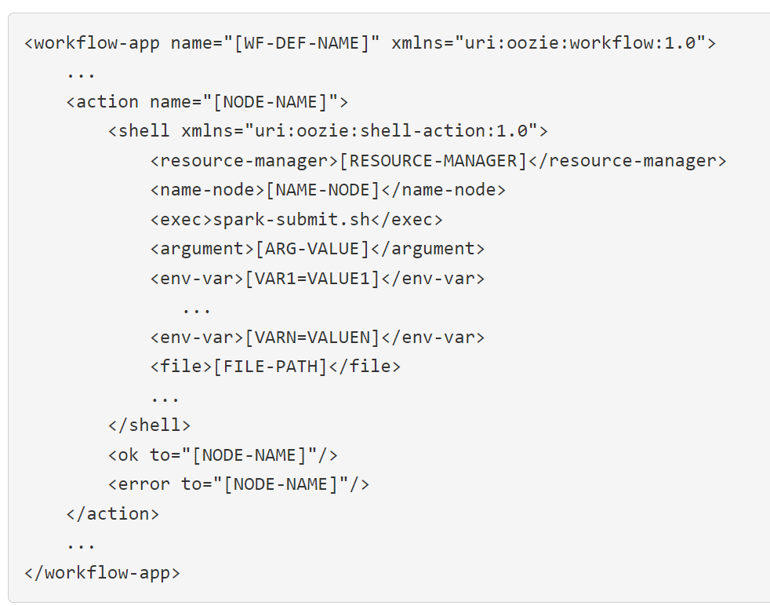
Oozie <shell> -> bash spark-submit.sh
workflow.xml
$ curl –X POST /oozie/job –d @config.properties
config.properties
oozie.wfapplication.path=hdfs://app/workflow.xml

Slide 64
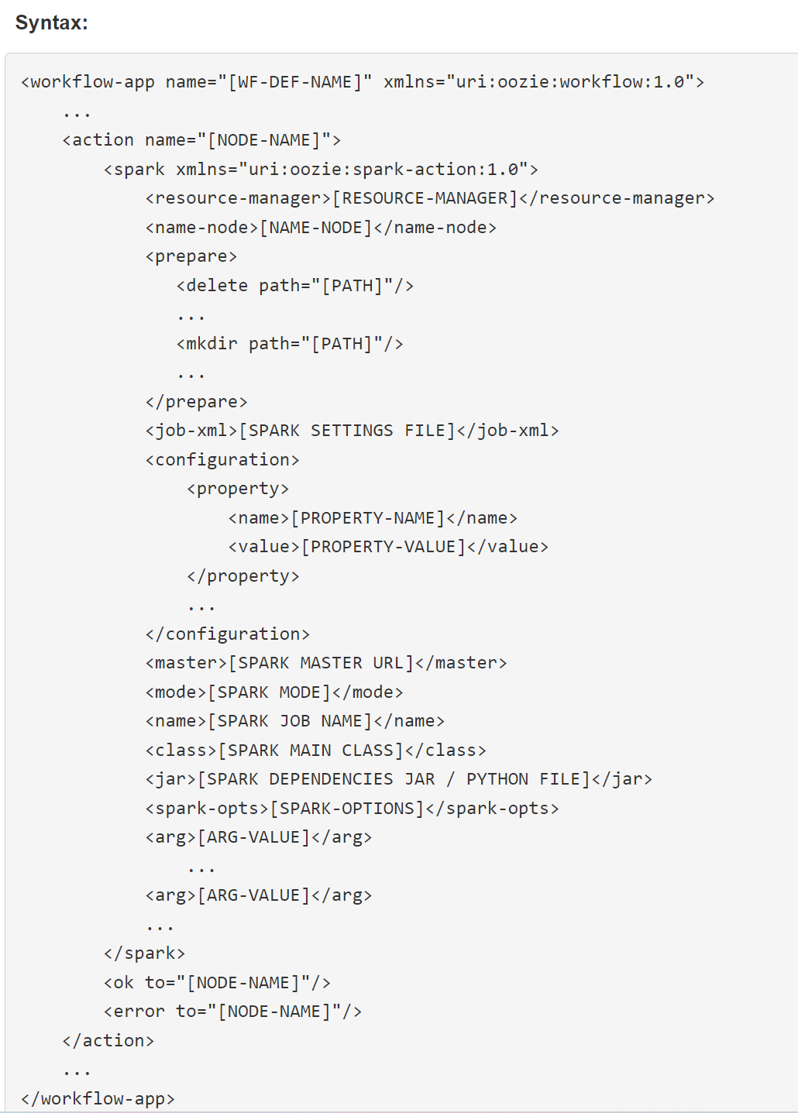
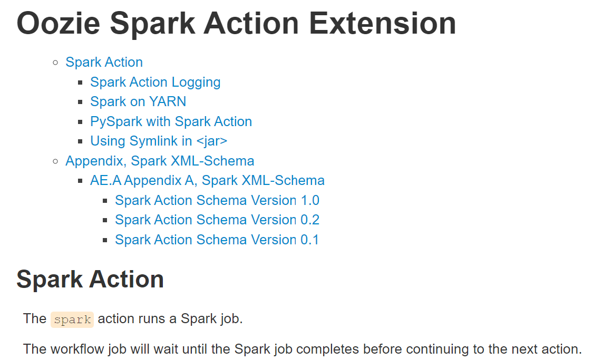
Oozie Workflow.xml - <spark>

Slide 65
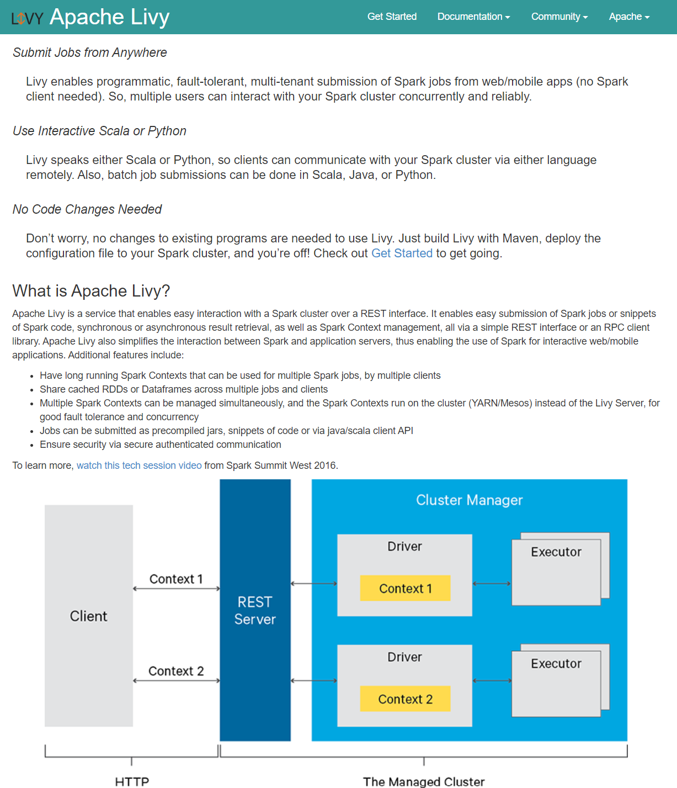
https://livy.apache.org/

Slide 66
Livy … submit via http Statefull batch / session
POST /batches
GET /batches
GET /batches/{batchId}
GET /batches/{batchId}/state
GET /batches/{batchId}/log
DELETE /batches/{batchId}
POST /sessions
GET /sessions
GET /sessions/{sessionId}
GET /sessions/{sessionId}/state
GET /sessions/{sessionId}/log
POST /sessions/{sessionId}/completion
DELETE /sessions/{sessionId}
POST /sessions/{sessionId}/statements
POST /sessions/{sessionId}/statements/{statementId}/cancel
GET /sessions/{sessionId}/statements
GET /sessions/{sessionId}/statements/{statementId}

Slide 67
Livy Batch Sample
$ curl –x POST http://<livyhost>:8998/batches -d @req.json
req.json:
{
"executorMemory": "20g",
"className": "org.apache.spark.examples.SparkPi",
"file": "/path/to/examples.jar", "args": [1000]
}
spark-submit \
--master yarn --deploy-mode cluster \
--executor-memory 20G \
--class org.apache.spark.examples.SparkPi \ /path/to/examples.jar \ 1000

Slide 68
Livy (Interactive) Session - Statement
$ response = $( curl –x POST http://<livyhost>:8998/sessions -d session1.json )
session1.json:
{
"kind": "spark", "executorMemory": "20g",
"files": [ "/path/to/examples.jar" ]
}
response:
{
"id" : 2 ,
"appId" : " application_123_456",
"owner" : "user", "kind": "spark",
"log": [ « log line1 », « line2 » ],
"state": "started",
"appInfo": { … }
}
${id}
id=$( .. jq ‘.id’ )
$ statResp = $( curl –x POST http://<livyhost>:8998/sessions/ 2 /statements -d statement-req.json )
statement-req.json
{
"mode": "raw",
"raw": "{ \"code\": \" val ds = spark.sql(\" SELECT * from table1 \") \" } "
}

Slide 69
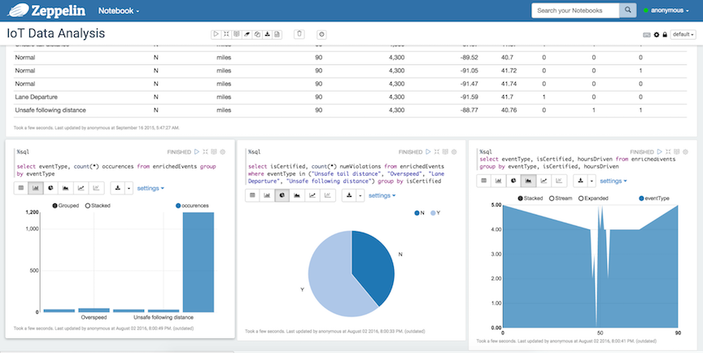
Zeppelin

Slide 70
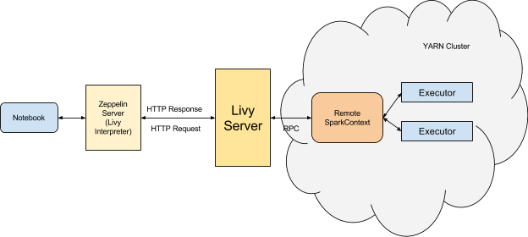
Zeppelin -> Livy Interactive Session

Slide 71
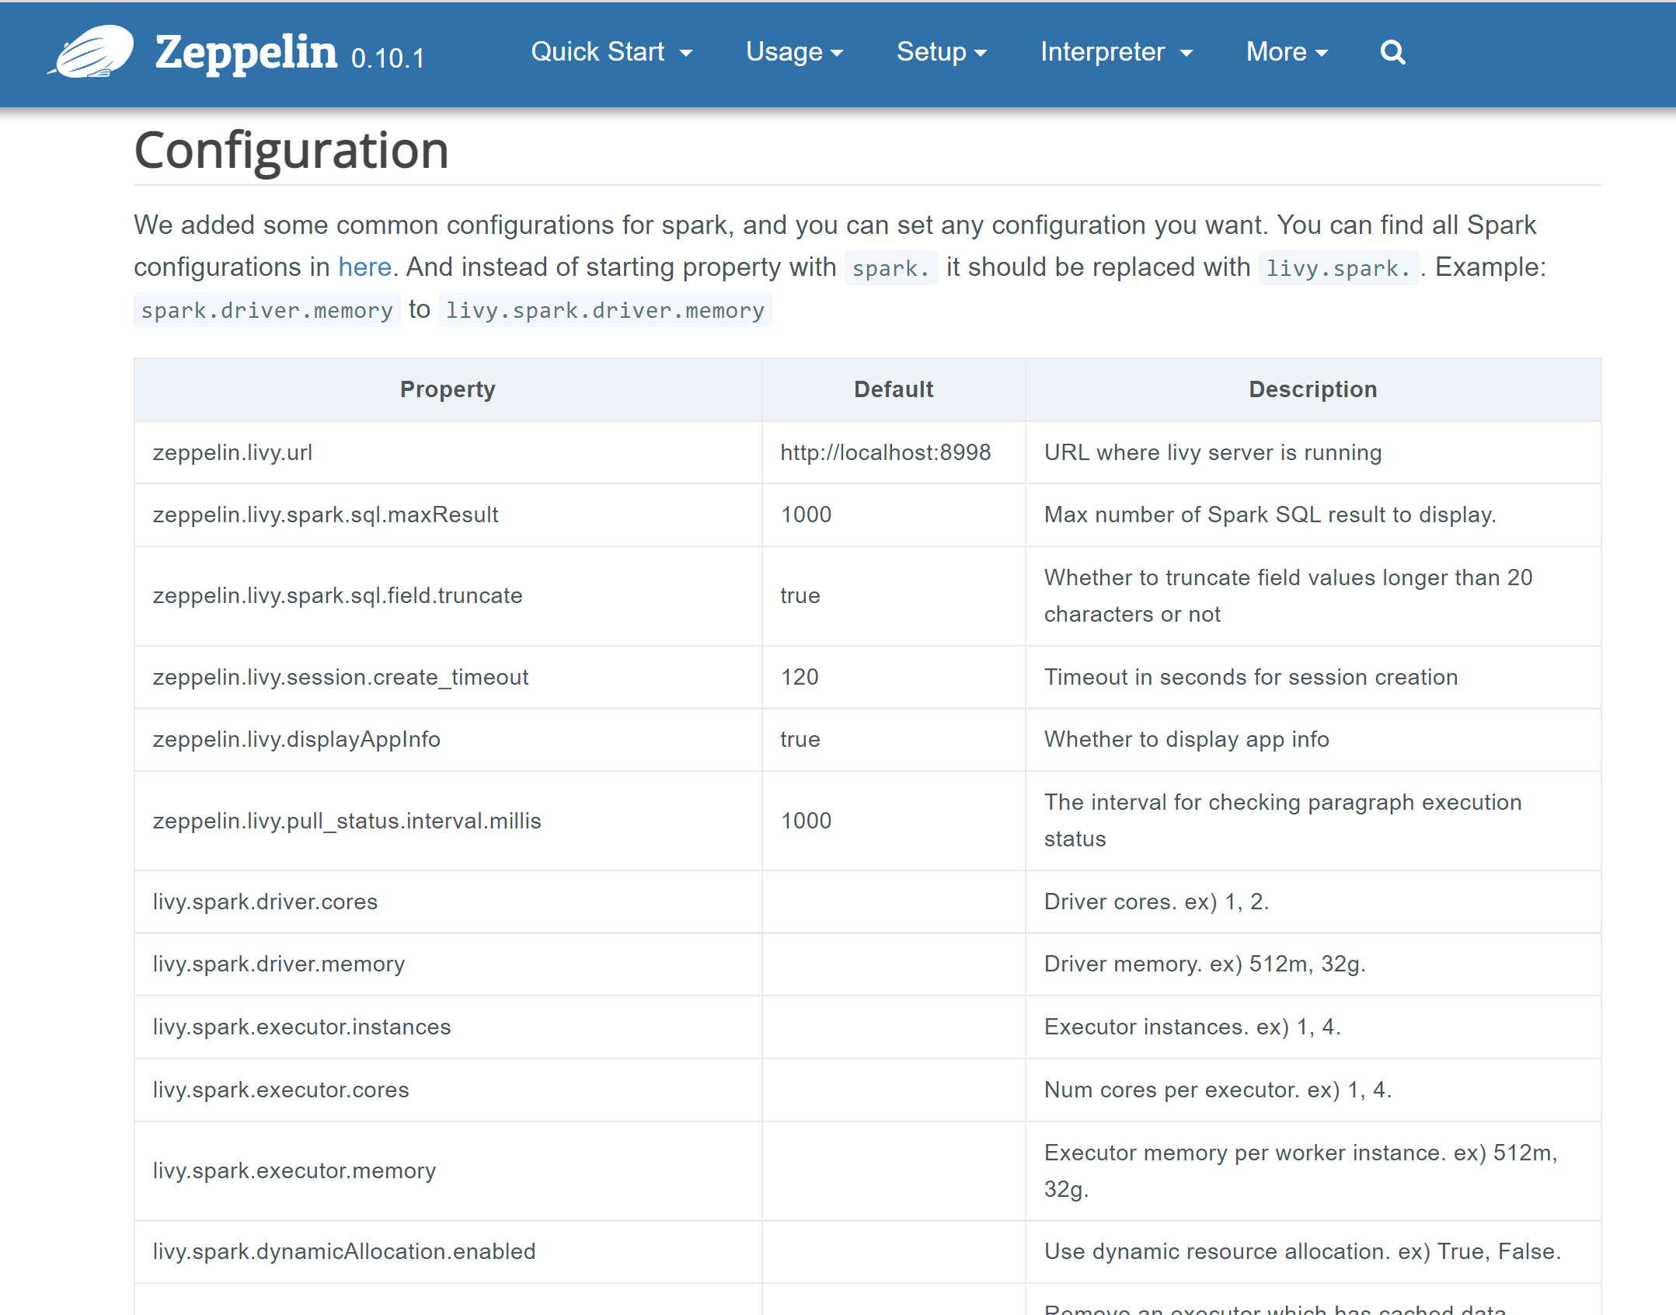
Config: livy.spark.*

Slide 72
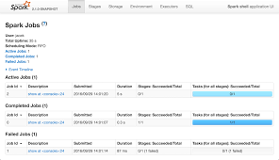
Link Zeppelin -> SparkUI Application
interpreter settings

Slide 73
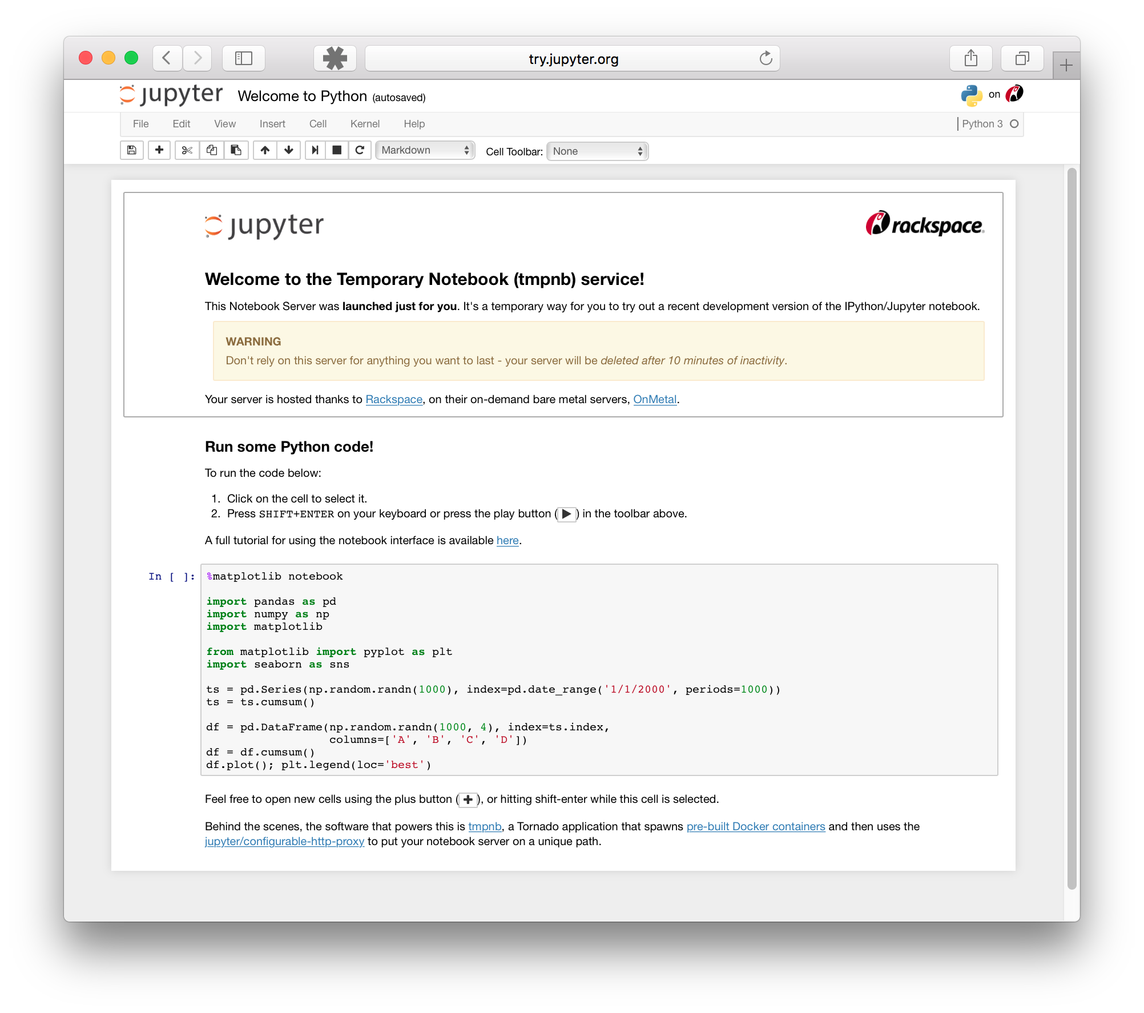
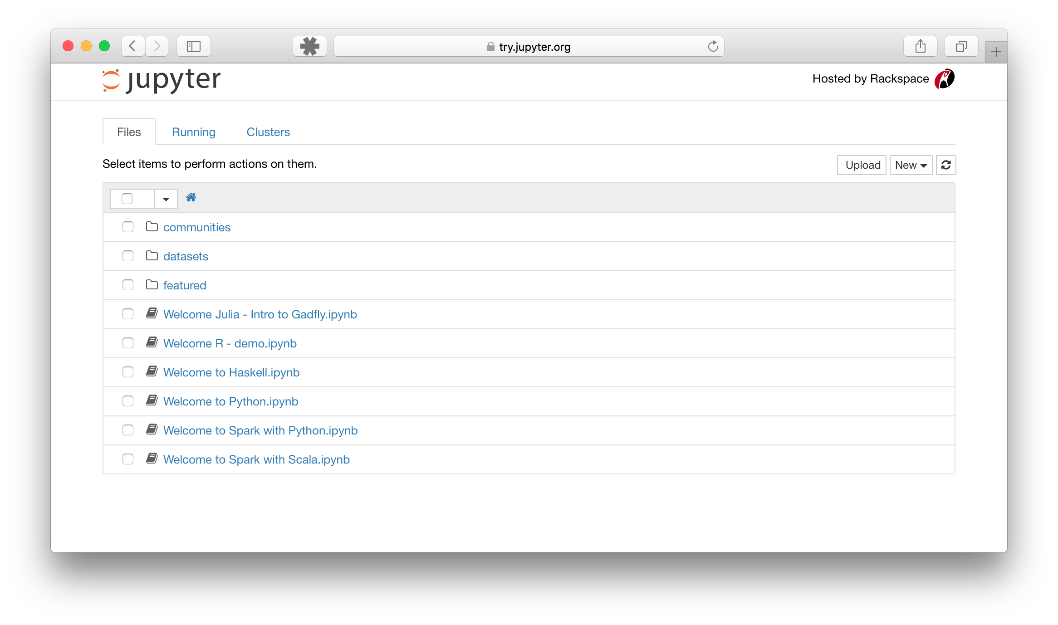
Jupyter Notebook

Slide 74
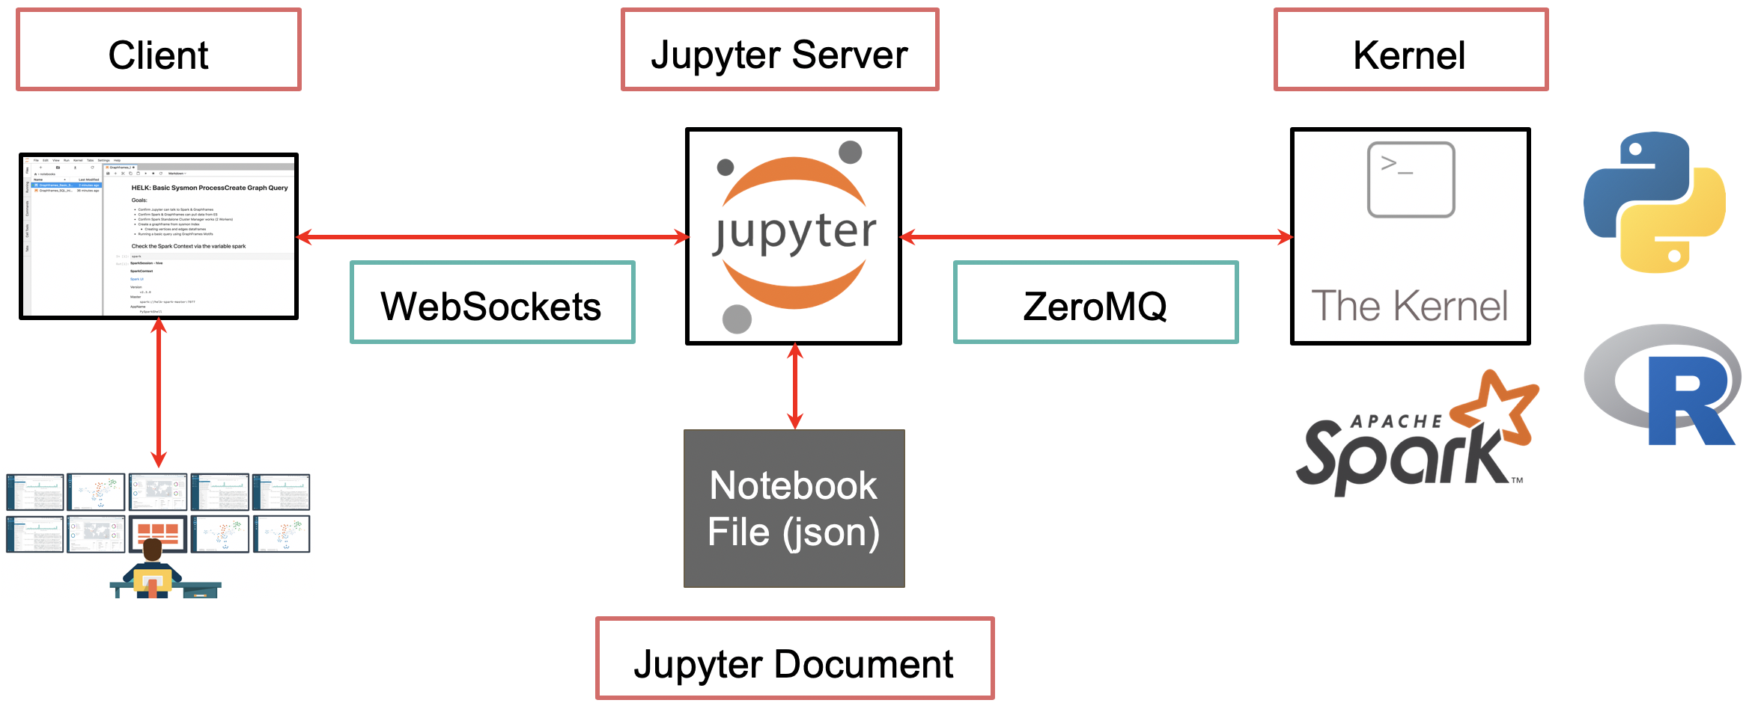
Jupyter – Kernel(s) architecture

Slide 75
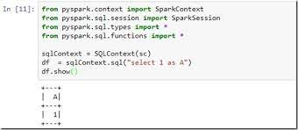
Jupyter + python kernel + pyspark

Slide 76


Slide 77
More « Extensions » backport API to other Langages (Python, R)
Reminder
class DataFrame:
… hundred methods …
def method123 (self, x) -> Y
self._jdf.method(x, self.sparkSession)
API
API
public class Dataset {
… hundred methods …
public Y method123 (X x) {
… internals sparkContext…
}
py4j
from py4j.java_gateway import JavaObject
from subprocess import Popen from pyspark.context import SparkContext
..
pid = Popen(« spark-submit » …)
Socket(.. )
SparkContext

Slide 78
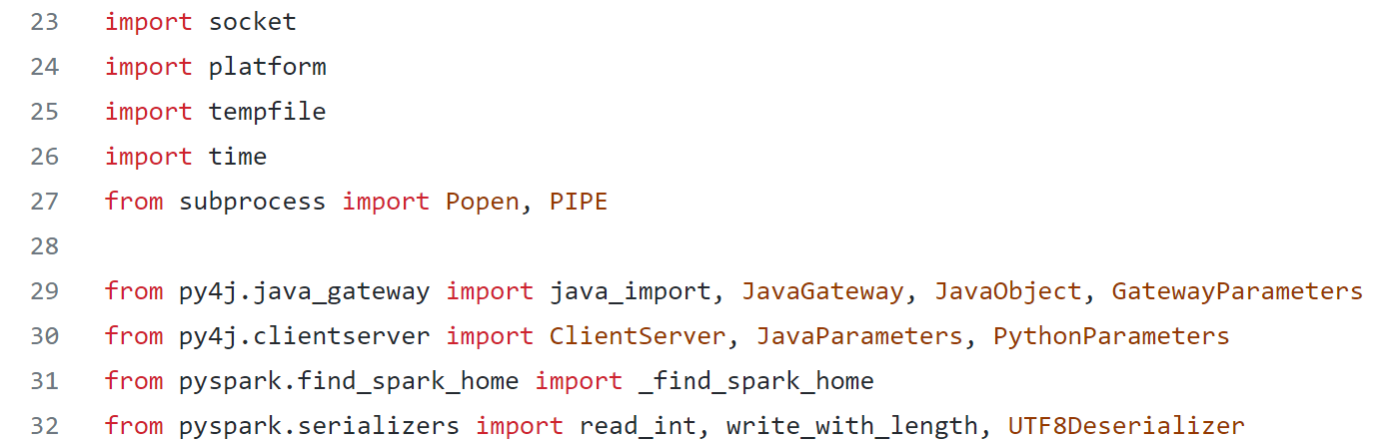

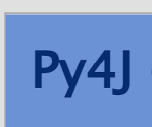
Python + pyspark ( GLUE package ) … = spark JVM proces + socket
$ pyspark
SparkContext (spark-driver)
Popen(‘java.exe’, …)
python.exe
socket
Write python Object
to pickle format
read java Object from pickle format
https://www.py4j.org/

Slide 79
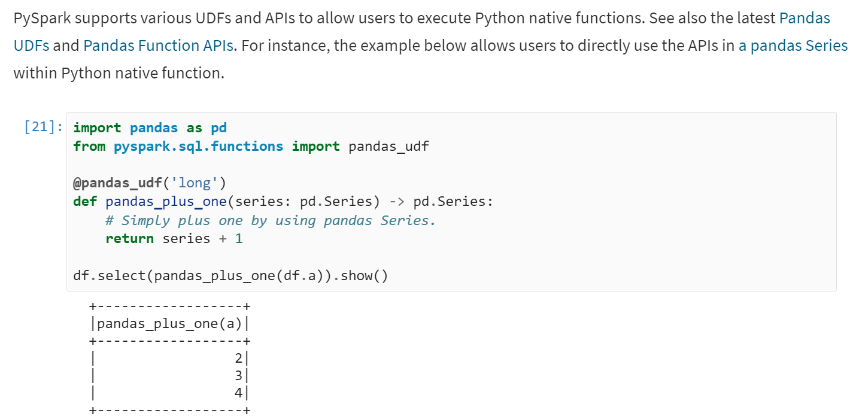
Python UDF function
spark-executor
Python.exe runner
System.exec(‘python.exe’, …)
socket

Slide 80

Pyspark – py4j – Spark Architecture
spark-executor
Local socket
pyspark
spark-driver
Partition1
SparkContext
spark
Local socket
Dataset
df
spark-executor
Local socket
$ pyspark
from pyspark.sql import SparkSession
spark = SparkSession.builder.getOrCreate()
df = spark.select(« SELECT * TABLE table1 »)
Partition2

Slide 81
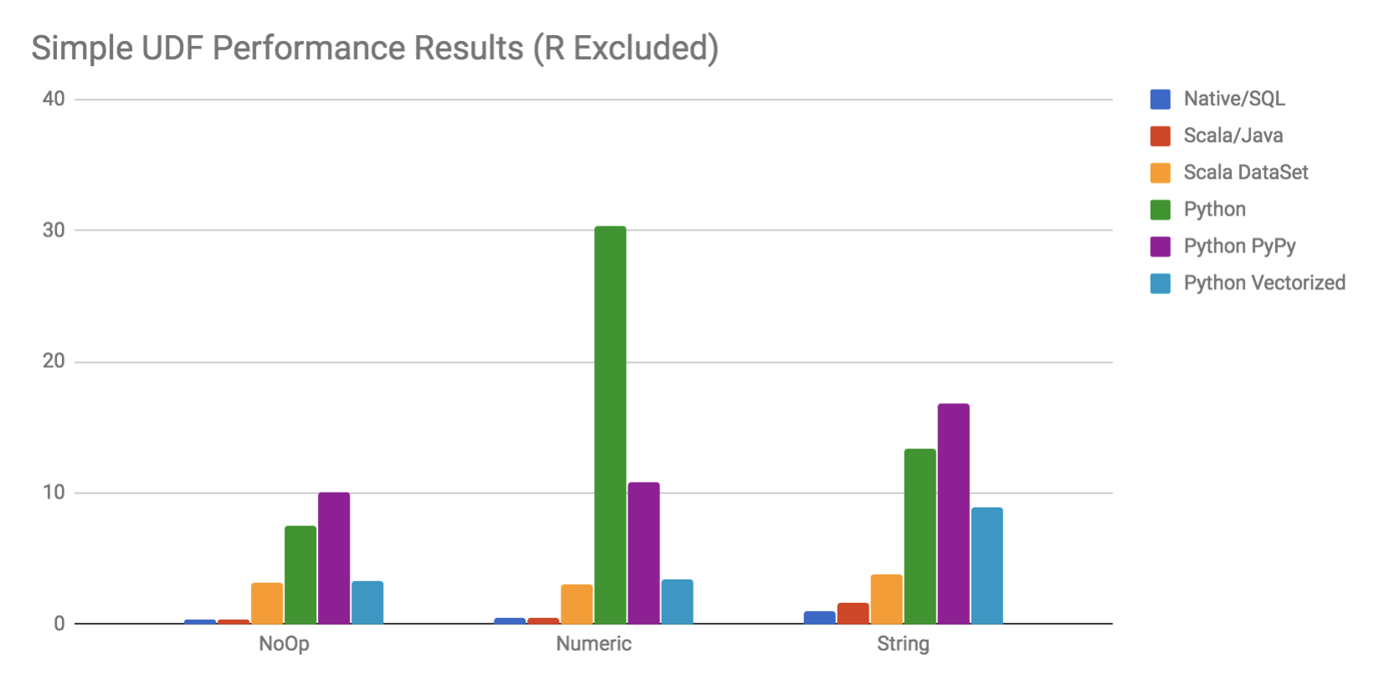
Python + Pickle = Performances Pourries

Slide 82
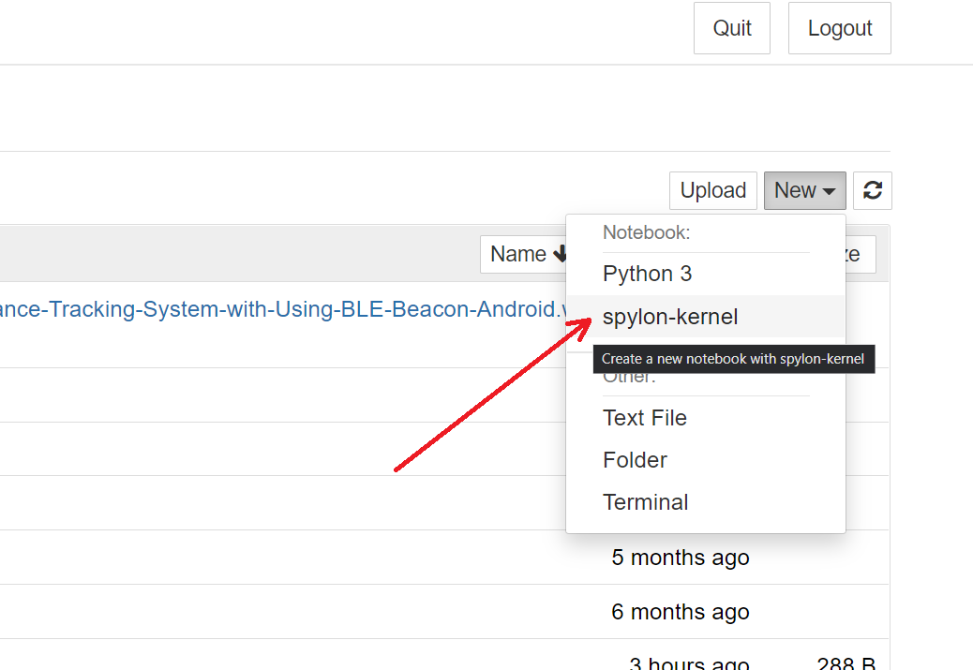
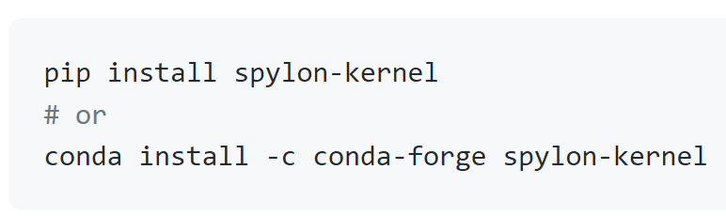
Jupyter + spylon (spark scala kernel)

Slide 83
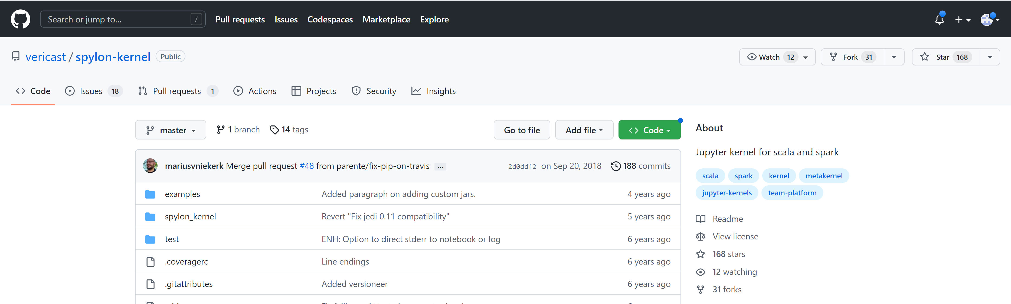
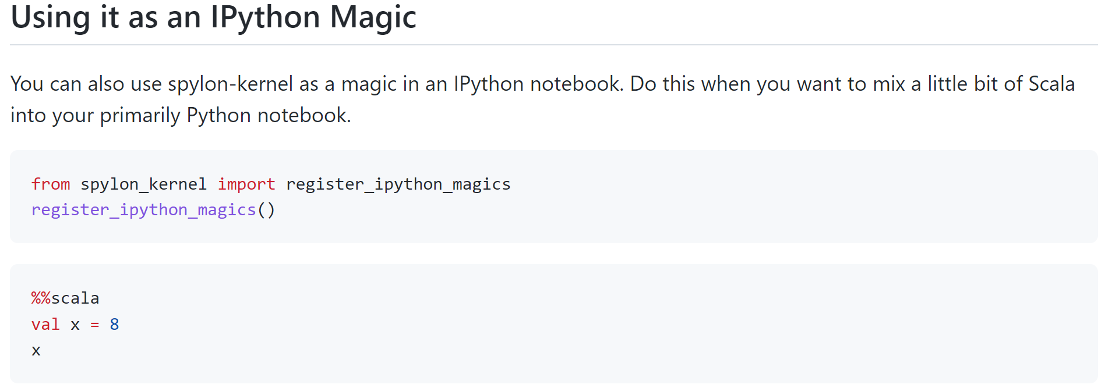
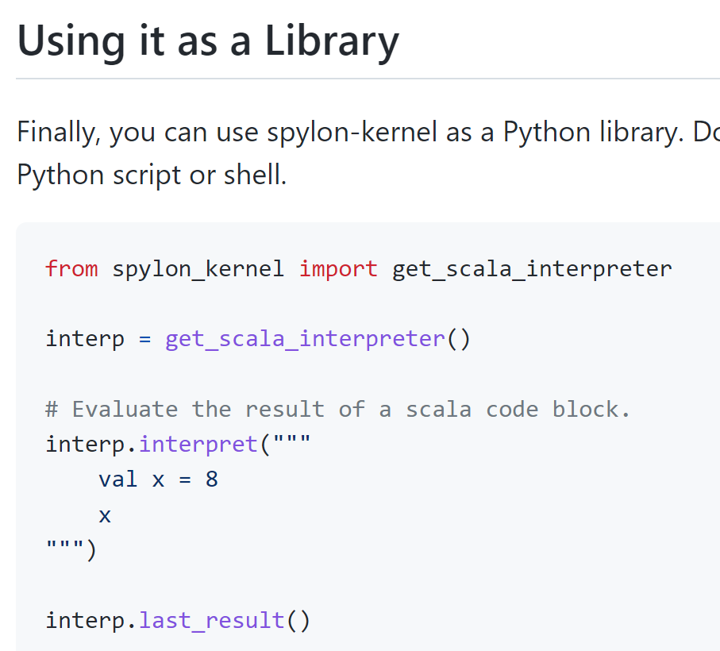
spylon : %%scala

Slide 84
Jupyter + spylon architecture
%%scala
Text
html
spark-executor
Partition1
spark-driver
%%scala
SparkContext
socket
spark-executor
spylon-kernel
Dataset
Partition1

Slide 85
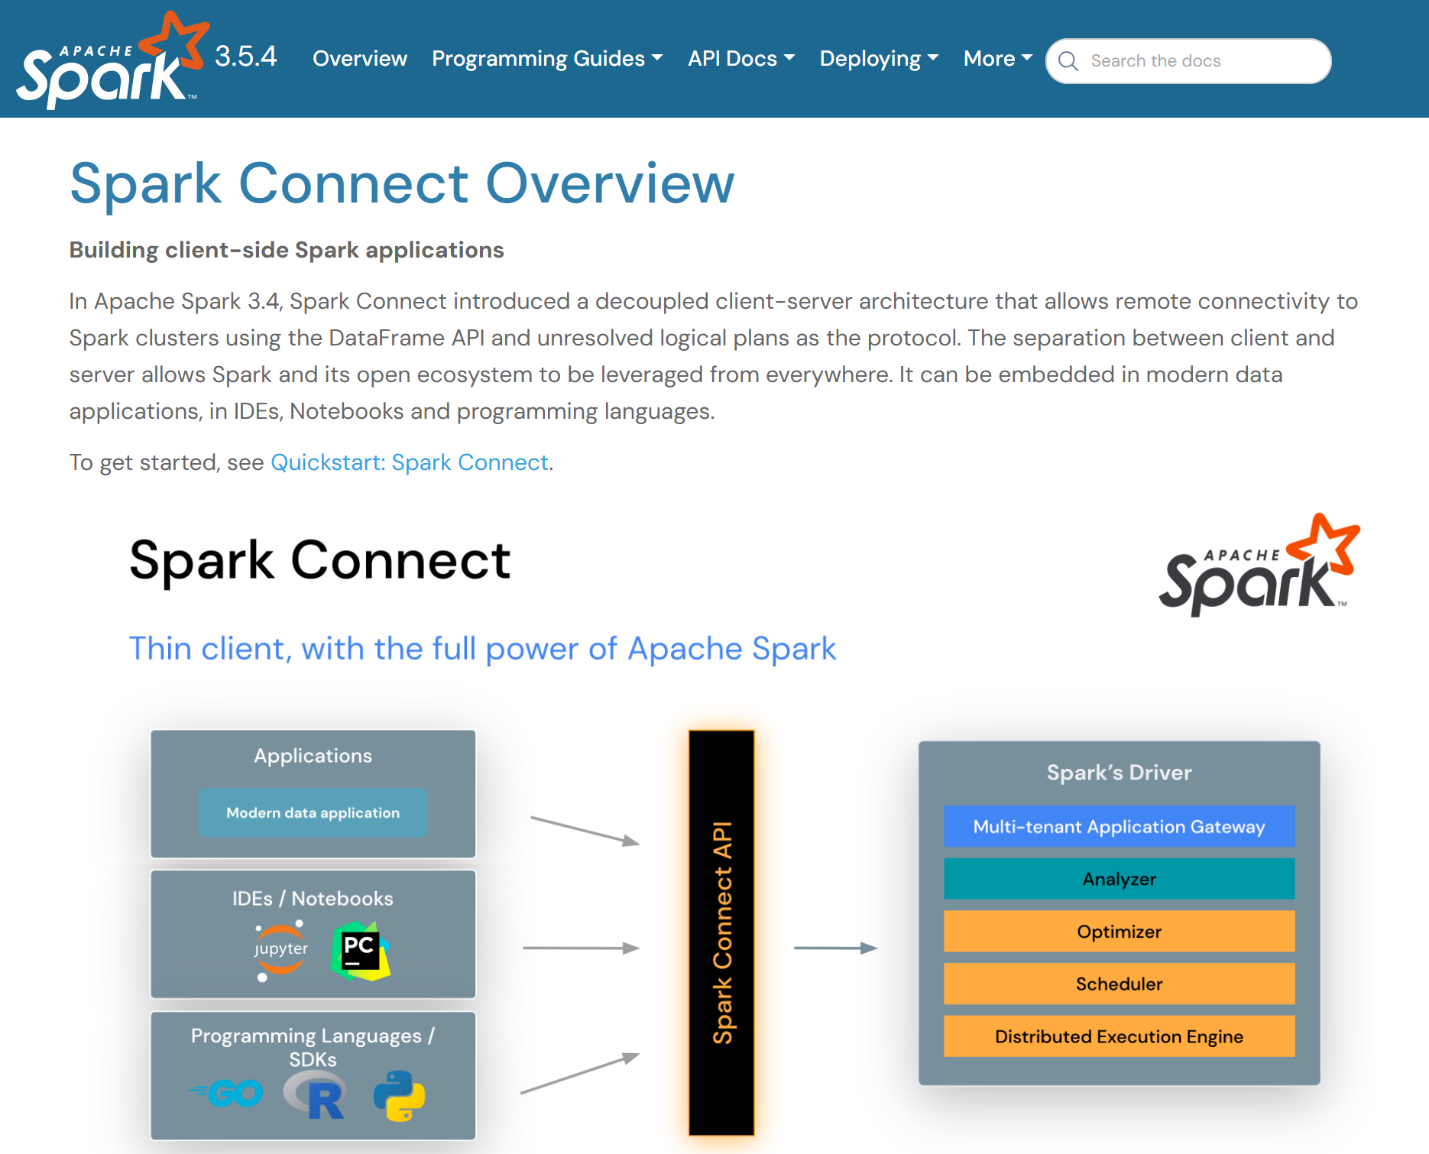
Spark Connect ... new since version 3.4

Slide 86
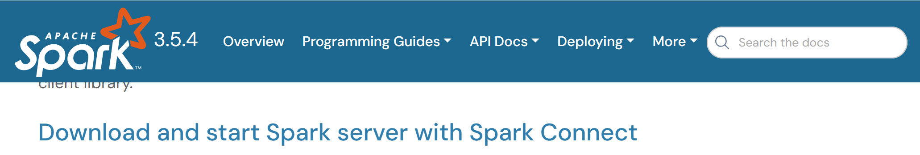
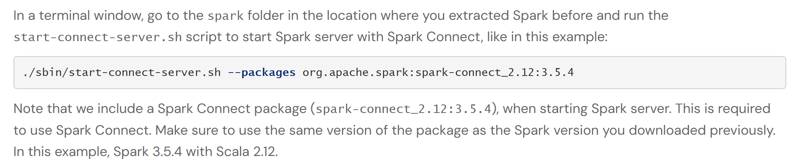
./sbin/start-connect-server.sh
spark-connect-server
(spark-driver + gRpc)
SparkContext
TCP socket
gRPC
protobuf
Dataset

Slide 87
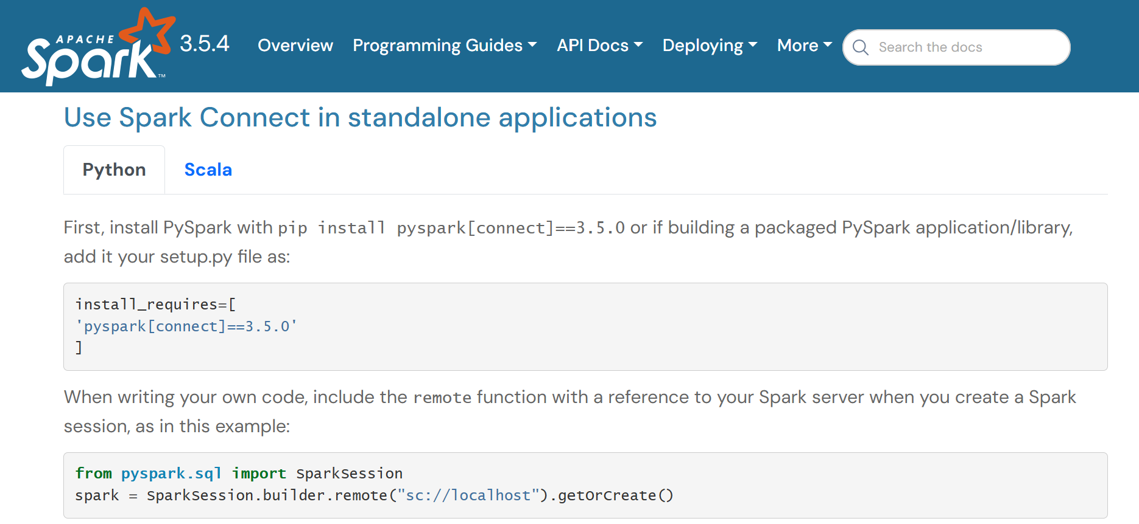
example: Spark Connect via python (no need JRE on client)

Slide 88
Enough for Today !
… but more to come
Questions are Welcome

Slide 89
Take Away What Did you learn ?

Slide 90
MindMap
Python
kernel
Py4j
+ socket
(perf..)
spylon
Zeppelin
spark-connect
session
Jupyter
spark
yarn
PySpark
mesos
batch
Livy
local[*]
kubernetes
Oozie
cluster management (spi)
--driver-memory 1g
--executor-memory 50g
Launchers
2 jvms
( Spark-submit =driver JVM )!
3 jvms
( Spark-submit =driver JVM )
Memory need driver << executor
kubectl
--executor-cores 8
simpler
better
cluster params
Task ThreadPool
yarn-client
yarn-cluster
Google operator
spark cluster & deployment
Warn to OutOfMemoryError
..link to –executo-memory
--deploy-mode
allocation
--master k8s://
yarn
Static allocation
--master spark://
kubernetes
--num-executors 5
mesos
Java JVM process
Dynamic allocation
--master local[*]
Run spark as embedded
--master
--spark.dynamic.allocation.enabled true
SparkSession spark = SparkSession.builder()
.master("local[*]")
.appName("myapp")
.getOrCreate();
K8s (Kubernetes) Cloud cluster
min,max,idle,..
Spark-client
Spark-driver
Node pool with Spot VM
Spark-executor
Node pool toleration
SparkContext
SparkSession
Driver (long running)
(spark-core)
(spark-sql)
executor (can be spot)

Slide 91
Questions ?
arnaud.nauwynck@gmail.com

